Slide 1
Criminal Behavior Analysis and Segmentation
Submitted by
SAHLA THAHSEEN
MCA

Slide 2
INTRODUCTION
Crime analysis is a systematic way of detecting and investigating patterns and trends in crime. Manual analysis of all crime cases is a cumbersome, time-consuming process prone to errors and biases.
Crime prediction and criminal identification are the major problems to the police department as there are voluminous data of crime exist.

Slide 3
Introduction
In this research, a novel Machine Learning based crime analysis method will be exploited for finding out the pattern of the crimes and criminals in the Indian context.
New Machine Learning based analysis could help the agency quickly and consistently discover important patterns in crime occurrences and empower police officers and analysts to enhance crime resolution rate and can increase operational efficiency.

Slide 4
EXISTING SYSTEM
Various studies have explored patterns of crime occurrence. These patterns can be divided into two categories:
spatial patterns
temporal patterns
crime pattern analysis remains an active research area in computer vision and Machine Learning in recent years. Numerous approaches have been proposed over these years.

Slide 5
PROPOSED SYSTEM
Voice detection mechanism is also involved in this.
This is helps to find threatening behaviour of person who call someone.
Detecting the call have any criminal behaviour or any other threatening behaviour.
If it have then report it to cyber police.

Slide 6
MODULE DESCRIPTION
CRIME ANALYSIS
Analyse all the crime happend in India by ploting and othe mechanisms
RISK ANALYSIS
Take voice as input and convert into text and the analyse the text is threating or not
RECOMMENDATION
If user select a location, check the perticular location is suite for travel or not by the data set of crime analysis

Slide 7
SOFTWARE AND HARDWARE SPECIFICATION
SOFTWARE SPECIFICATION
Front end:HTML,CSS,PHP
Back end:PYTHON,MYSQL
IDE:Anaconda Navigator
HARDWARE SPECIFICATION:
Pocessor :i3
Ram:4GB
Hard disk:500GB
Standard keybord,Mouse,15 Inch Monitor.

Slide 8
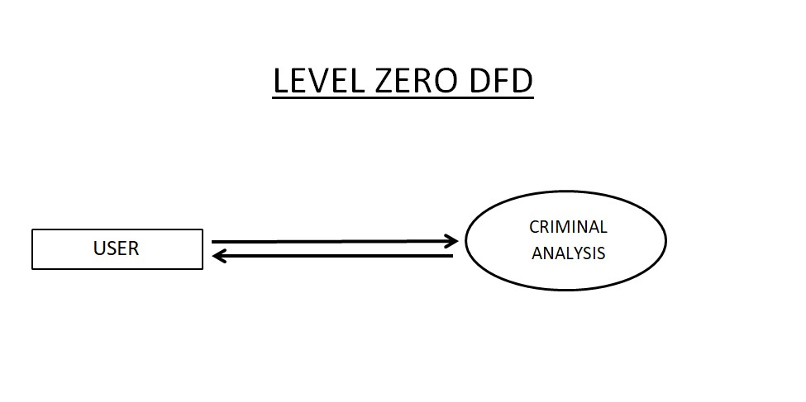
DFD

Slide 9
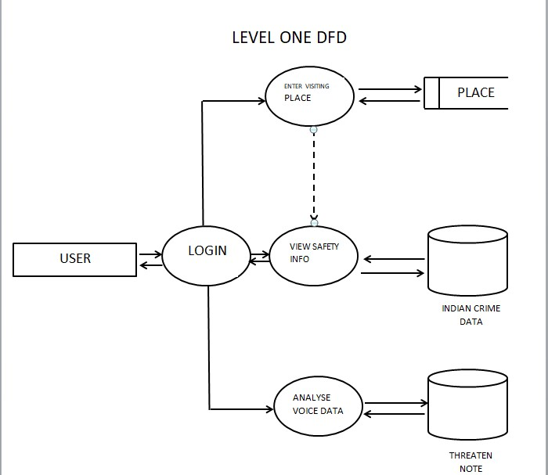
DFD

Slide 10
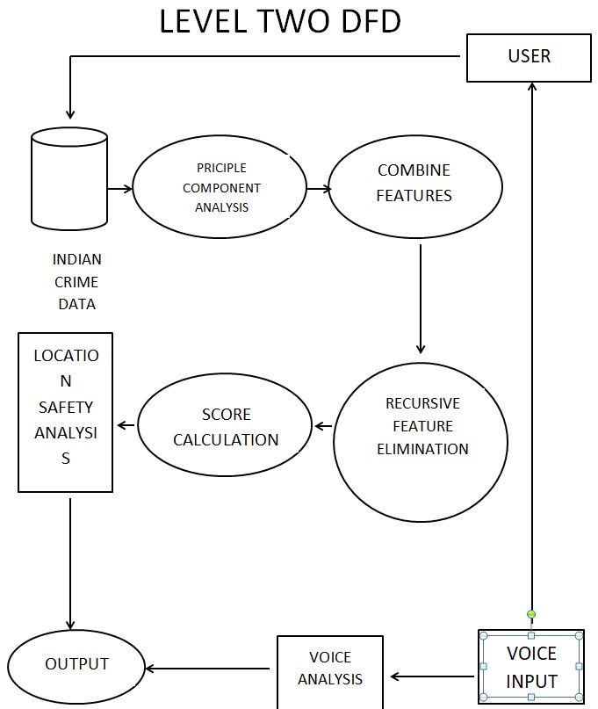
DFD

Slide 11
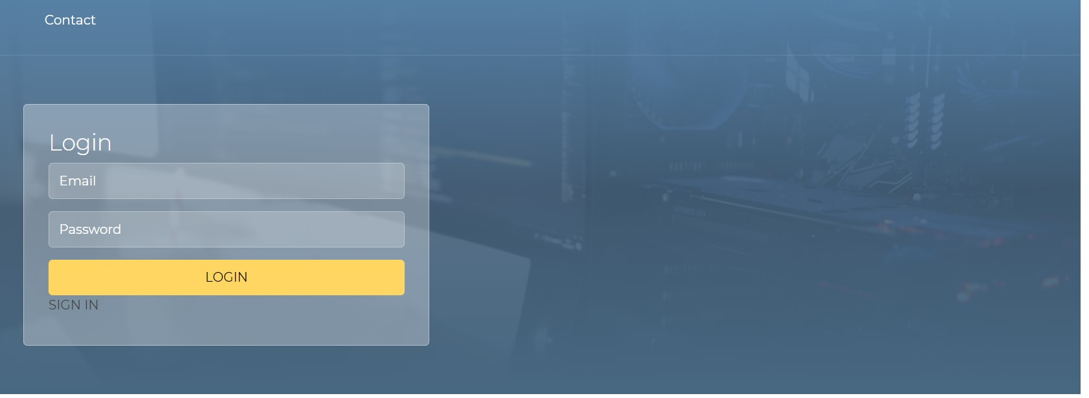
FRONT END

Slide 12

INPUT

Slide 13
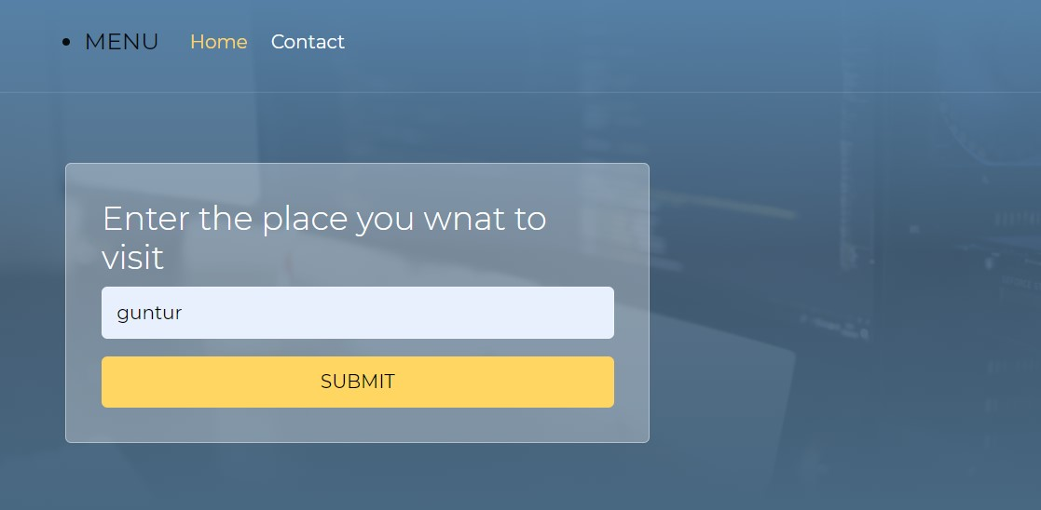
INPUT

Slide 14
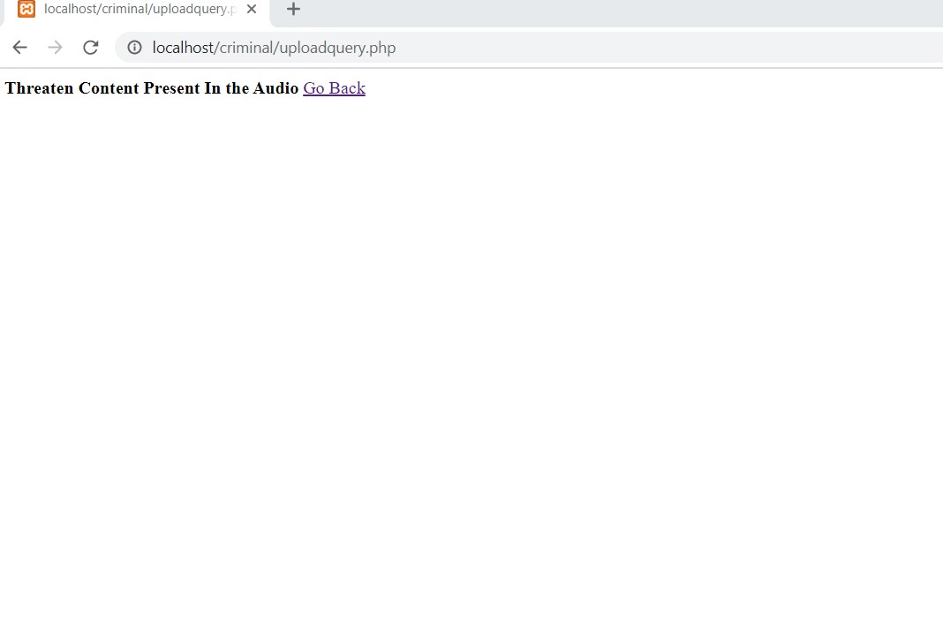
OUTPUT

Slide 15
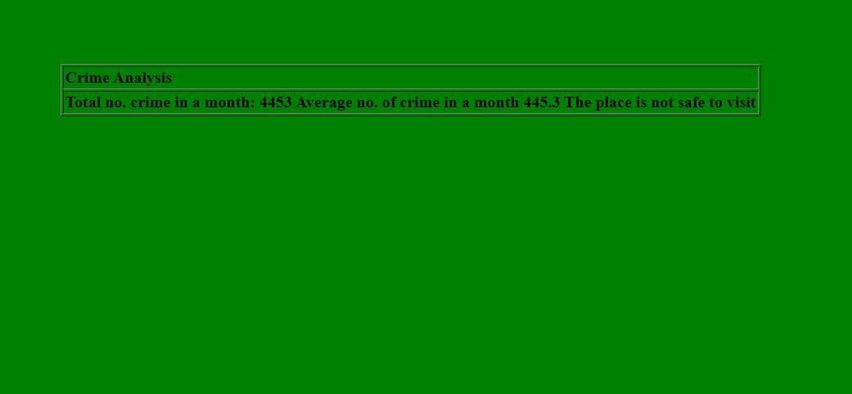
OUTPUT

Slide 16
CONCLUTION
New Machine Learning based analysis could help the agency quickly and consistently discover important patterns in crime occurrences and empower police officers and analysts to enhance crime resolution rate and can increase operational efficiency. On successful completion of the project it will deliver the functionality that will enable to analyze the crime dataset and produce meaningful insights.

